Slide 1

HEALTH-CARE PROJECT

Slide 2
OVER-VIEW
1.Installations
2.Configurations
3.Integrating github
4.Creating Jenkins file.
5. git checkout
6. Build the application
7. Build image
8. Docker login
9. Docker Push
10.Terraform Apply
11.Selenium Test Cases
13.Monitoring the Containered Application.

Slide 3
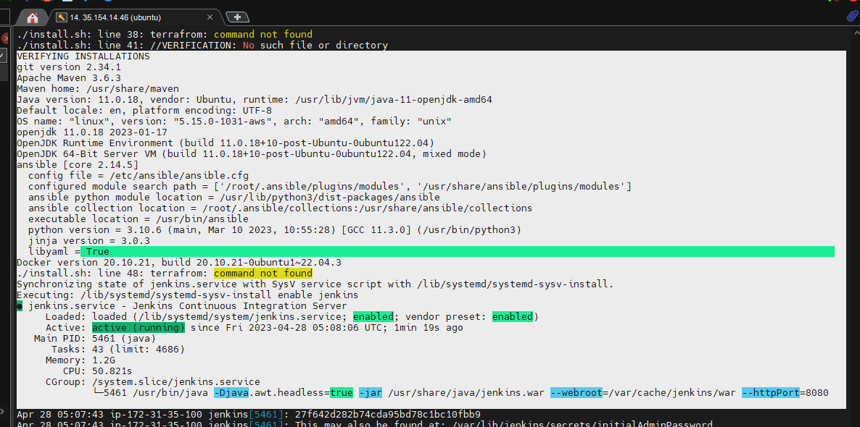
1.Installations

Slide 4
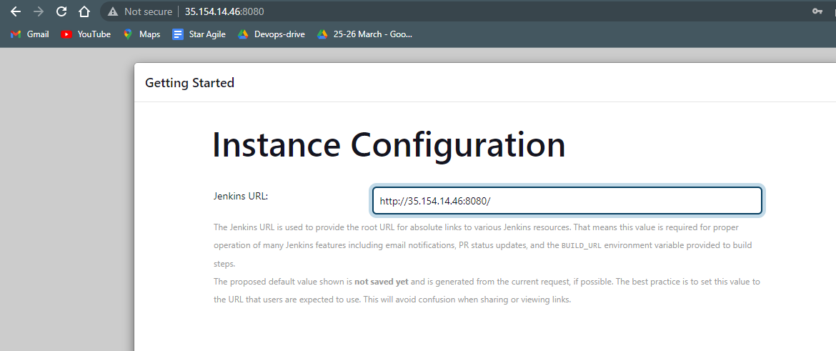
.Installating Jenkins

Slide 5
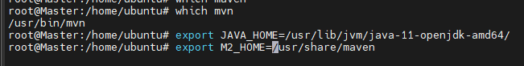
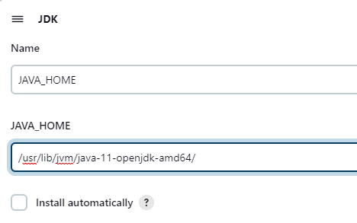
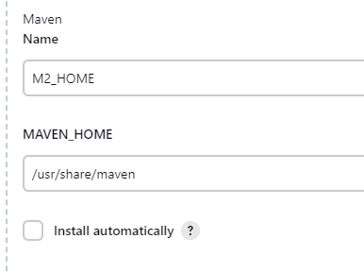
2.Configurations

Slide 6
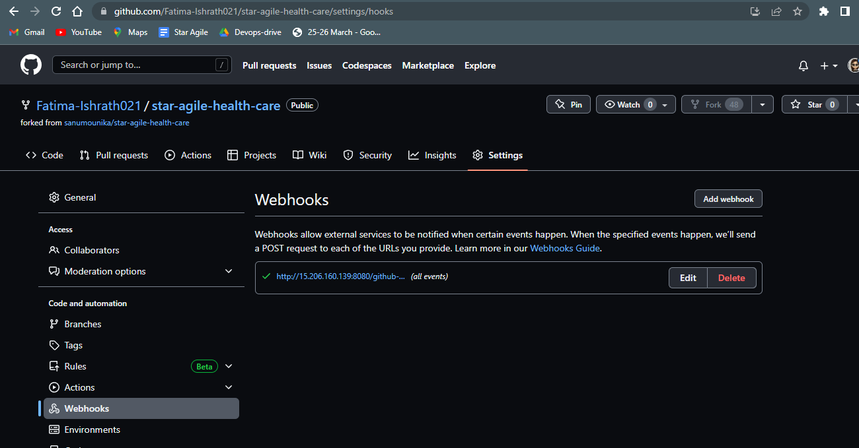
3.Integrating github

Slide 7
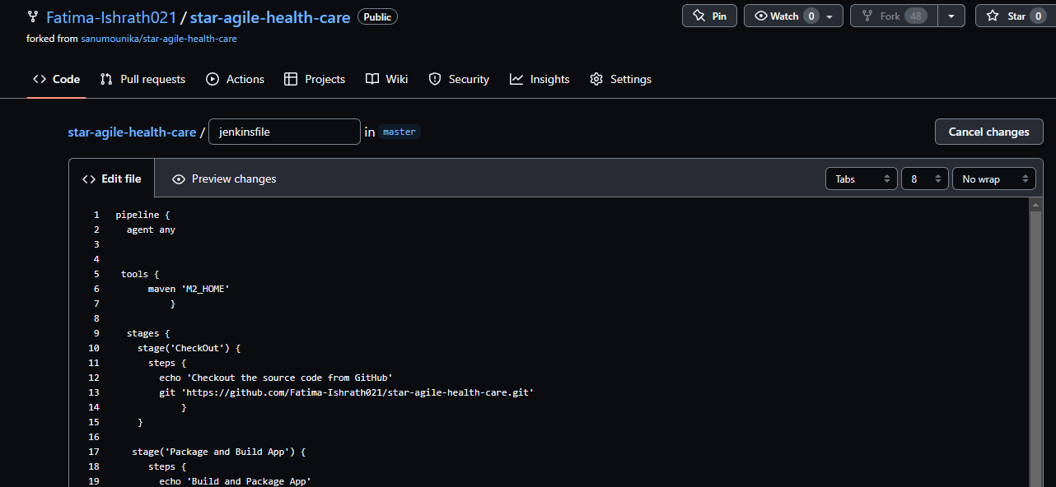
4.Creating Jenkins file.

Slide 8
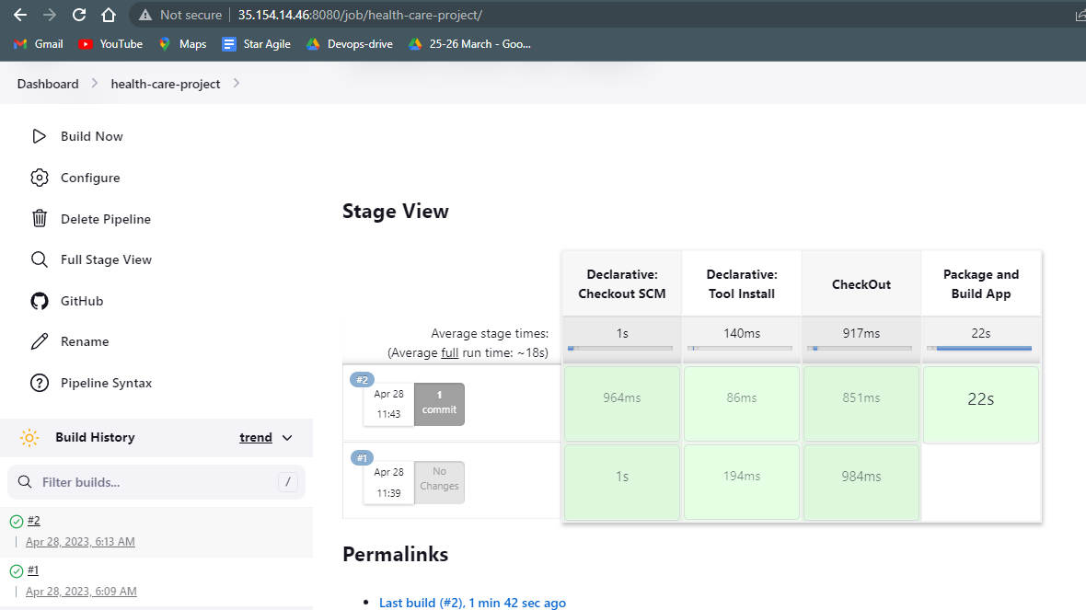
6. Build the application

Slide 9
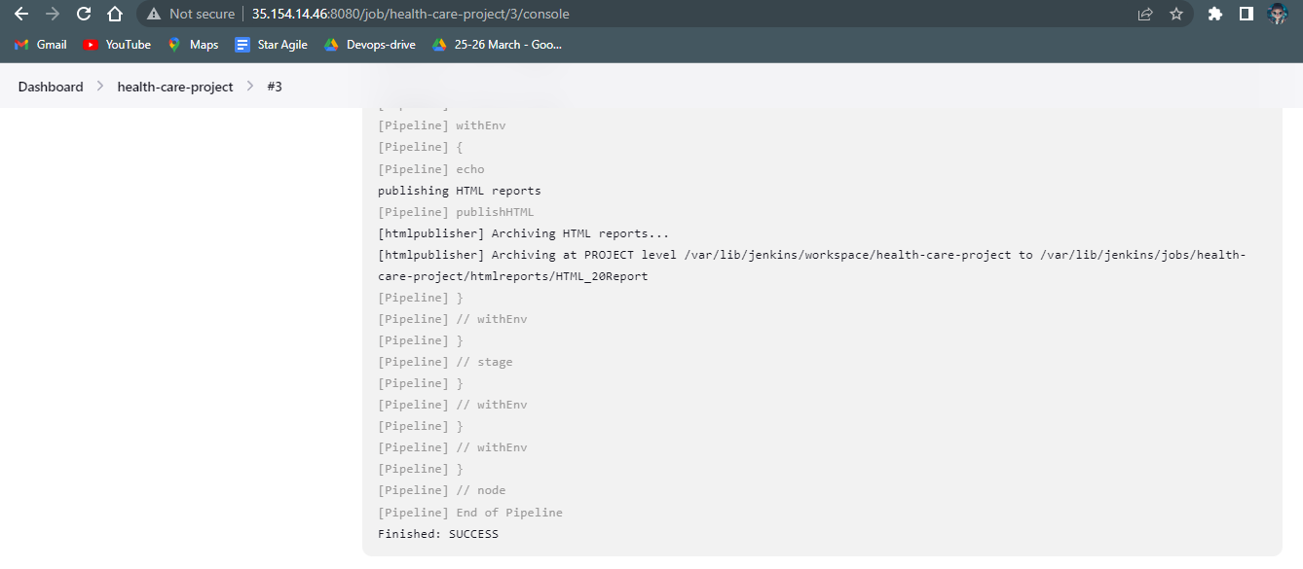
Publishing HTML Reports

Slide 10
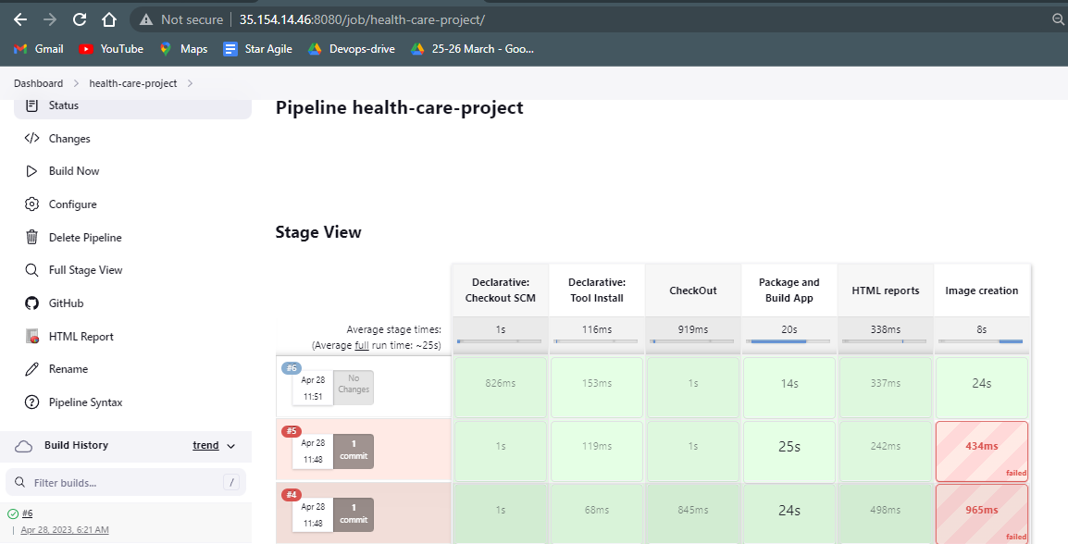
7. Build image

Slide 11
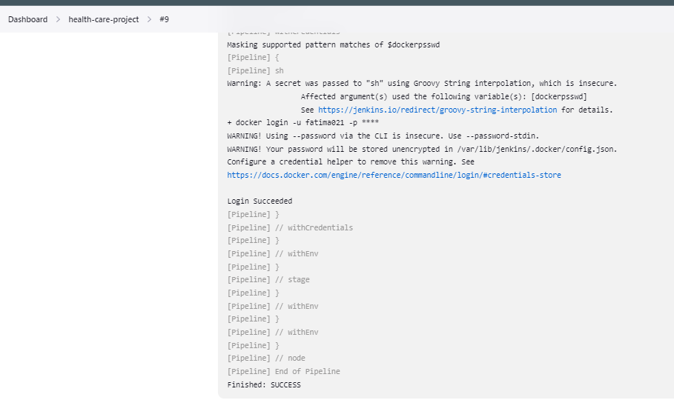
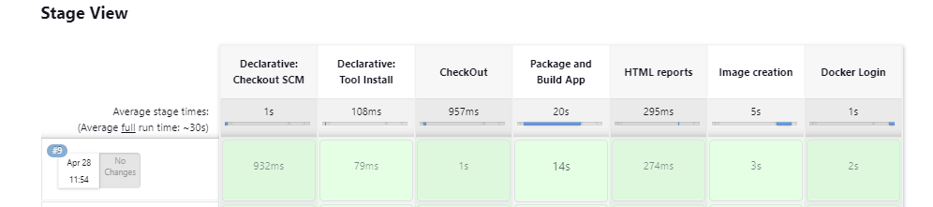
8. Docker login

Slide 12
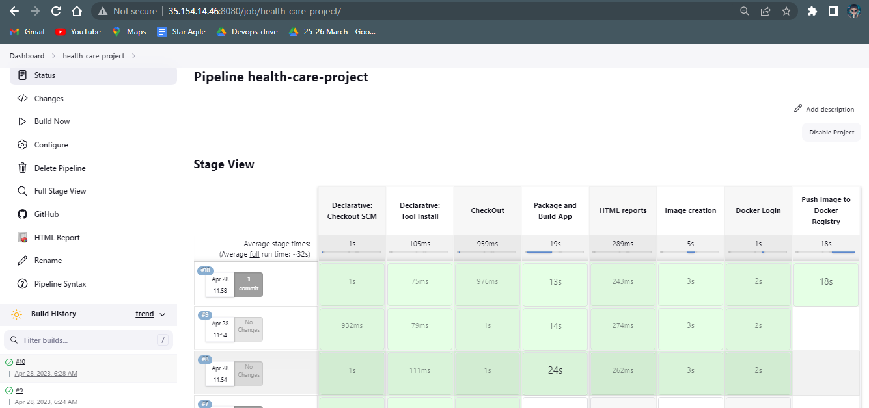
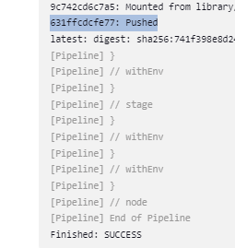
9. Docker Push

Slide 13
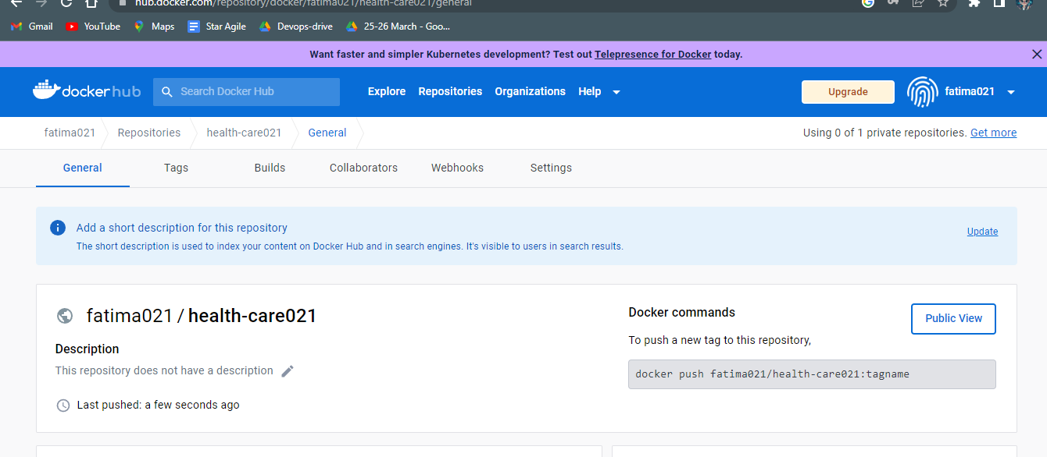
9. Docker Push verification

Slide 14
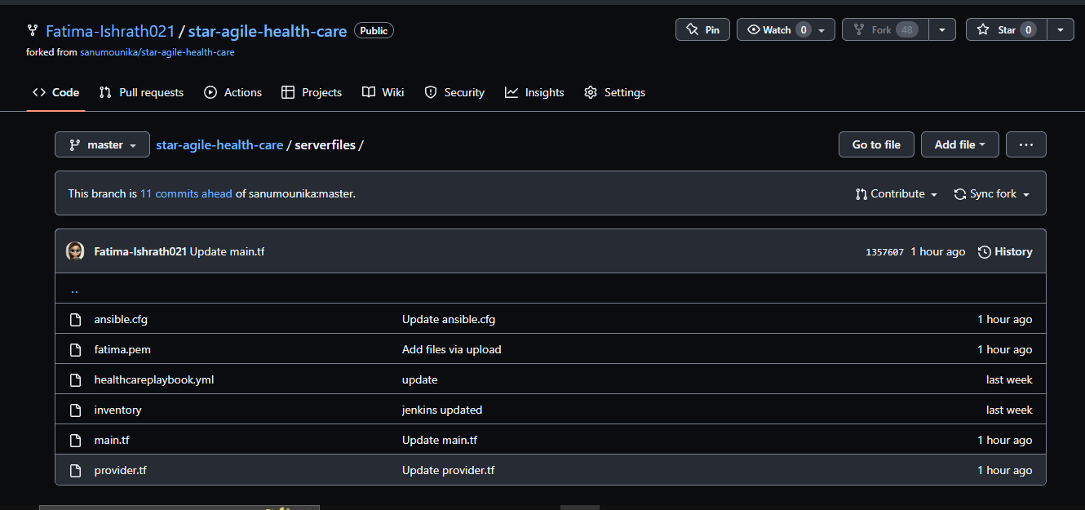
Create serverfiles

Slide 15
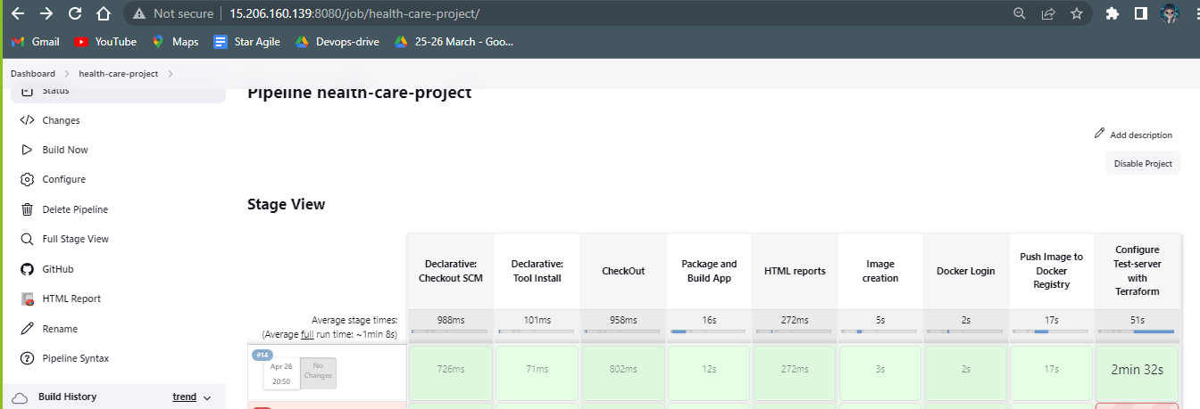
Building the Terraform deploying stage

Slide 16
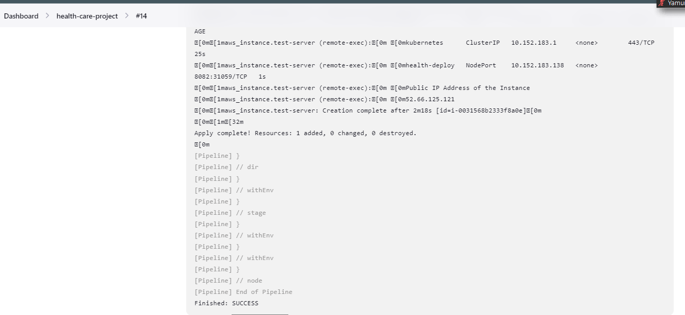
Successfully built the deployment stage.

Slide 17
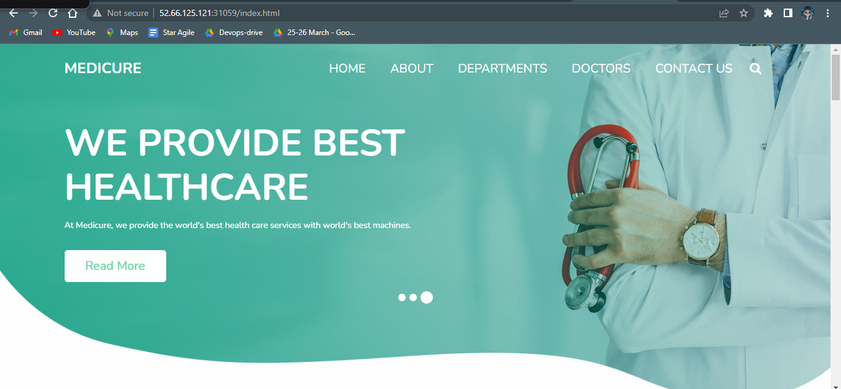
Verfiying on the browser.

Slide 18
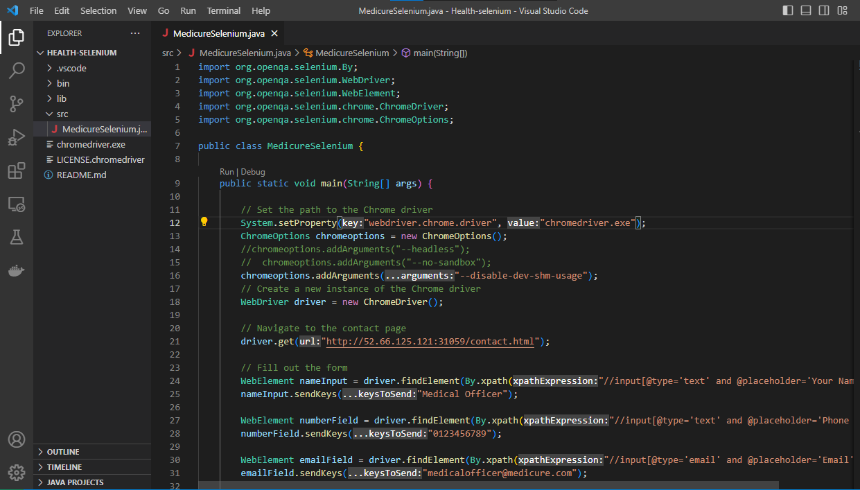
Importing the selinum java project.

Slide 19
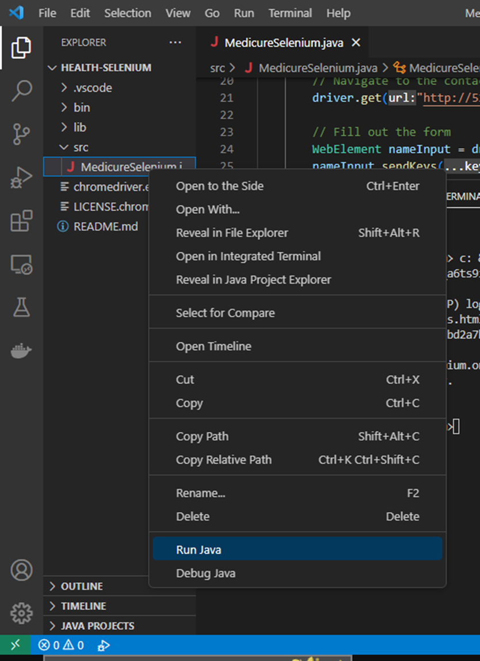
Running the selenium java project

Slide 20
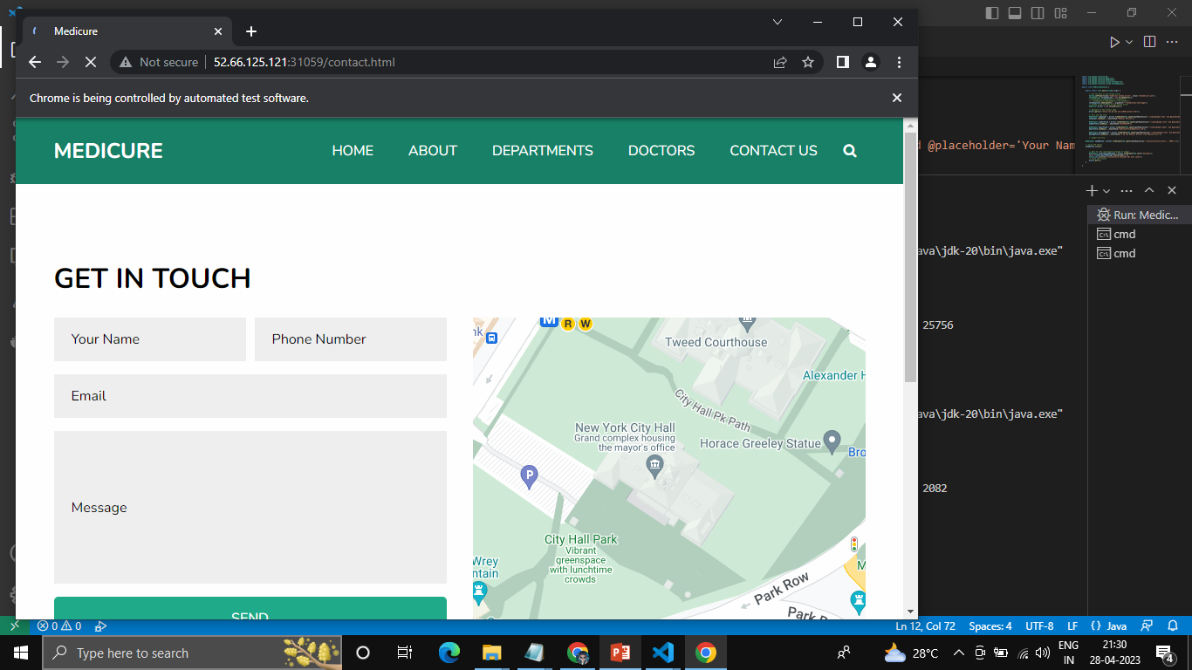
The Chrome-driver started successfully .

Slide 21
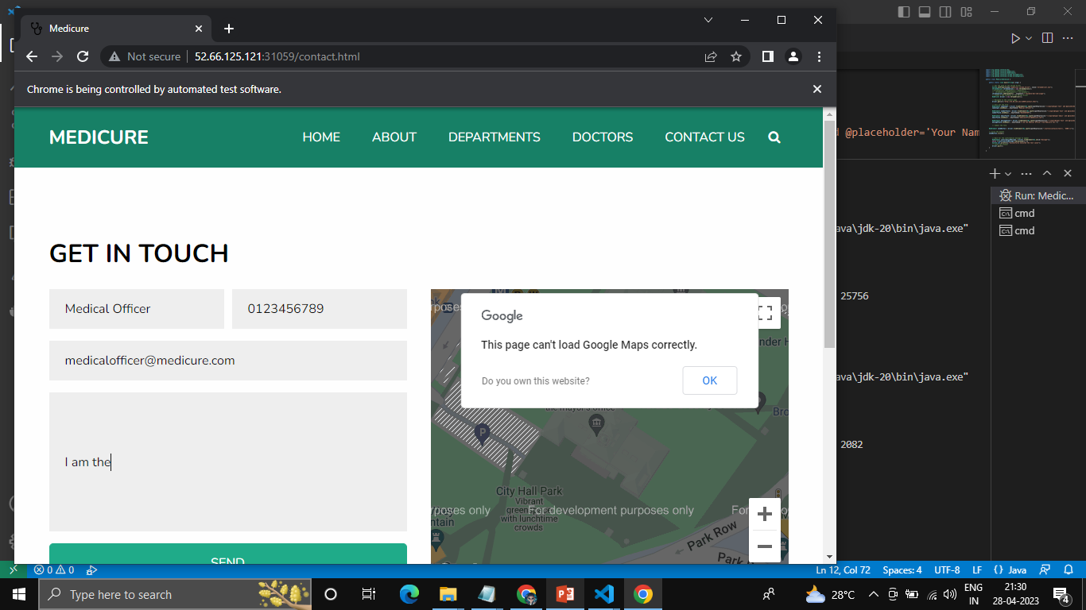
Selenium executed as it is.

Slide 22
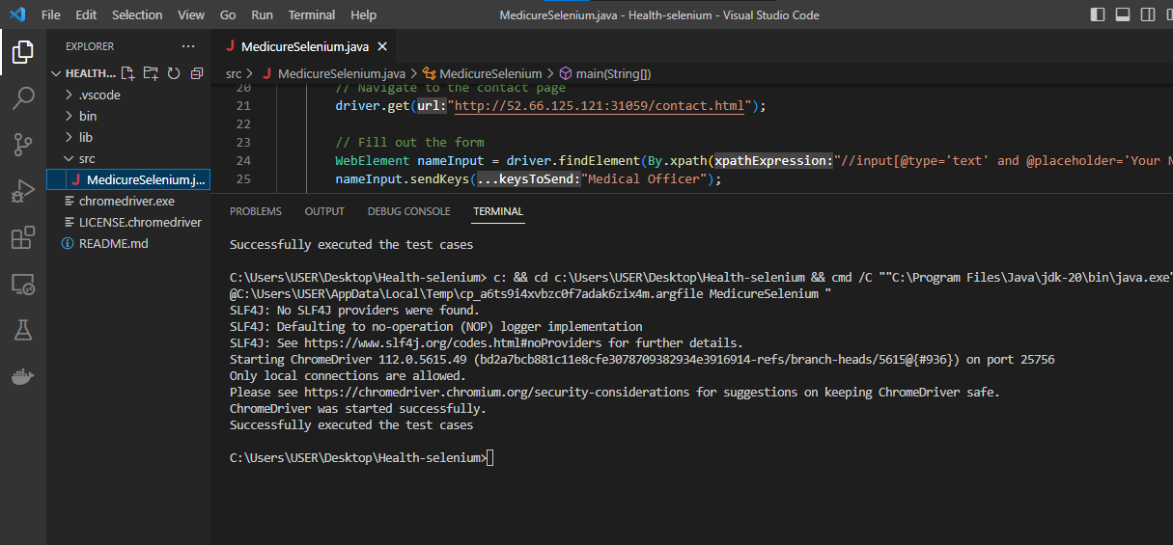
Successfully Executed the selenium test cases.

Slide 23
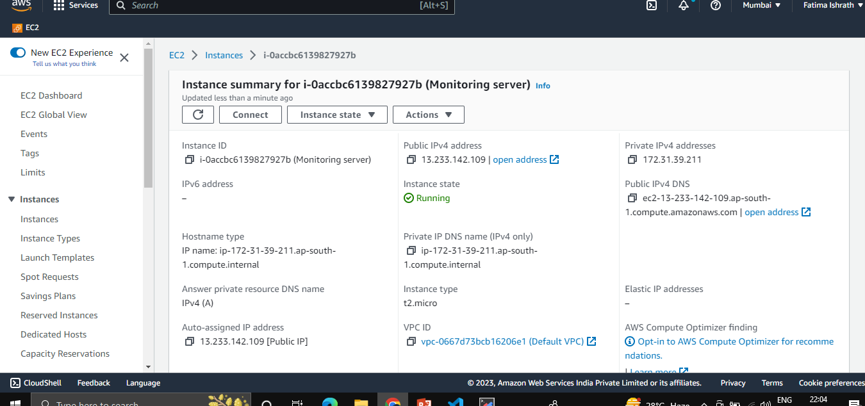
Launched another ec2 As Monitoring Server.

Slide 24
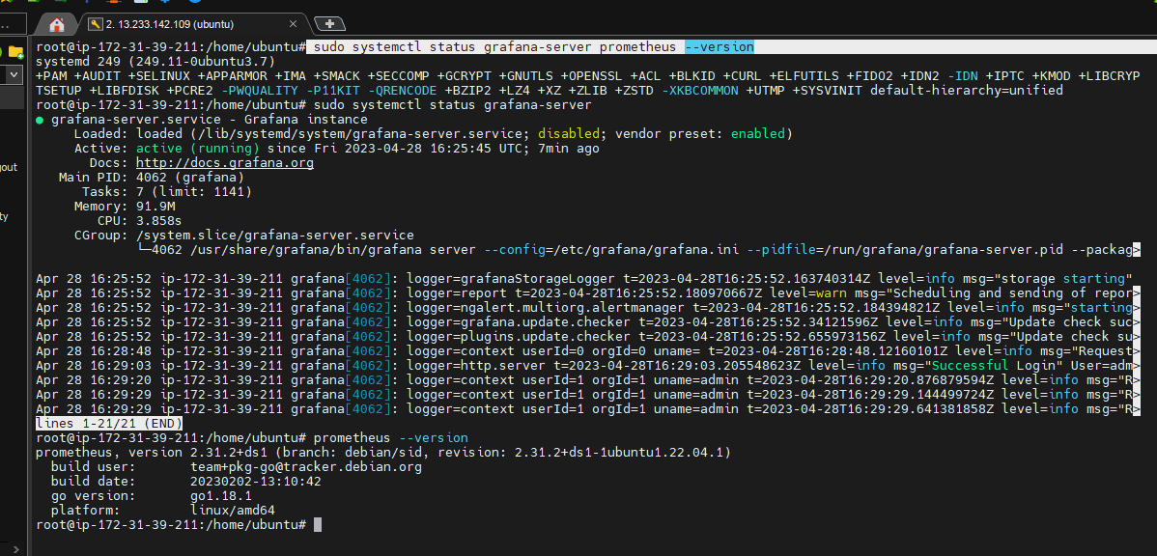
Verifying the installations of Prometheus and Grafana.

Slide 25
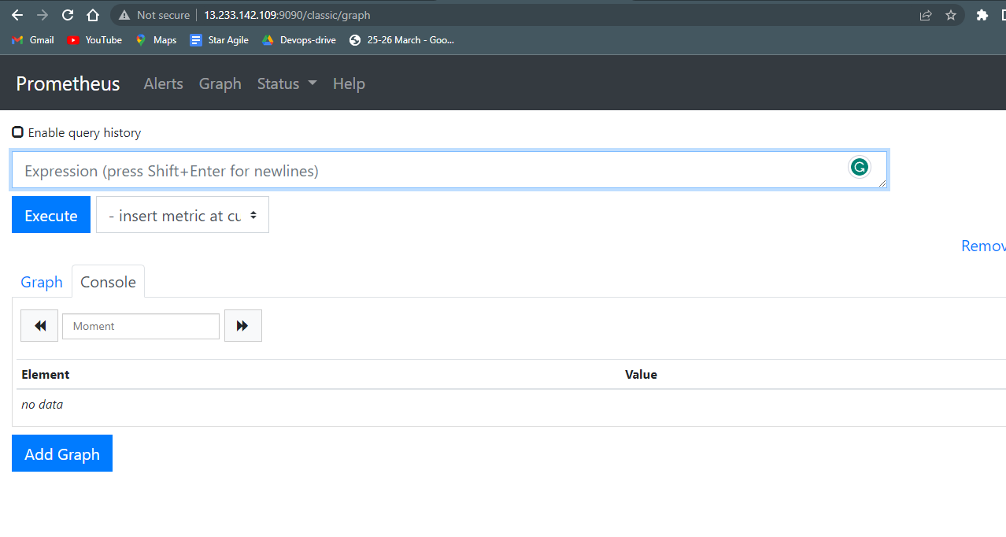
Prometheus running on Monitoring server

Slide 26
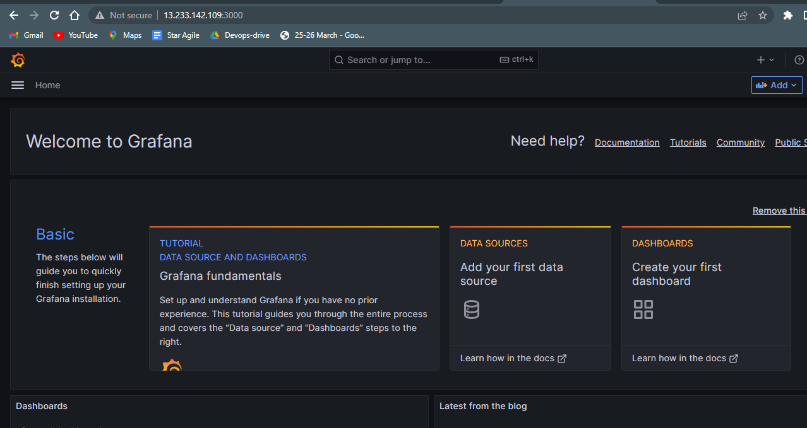
Grafana Running on Monitoring server

Slide 27
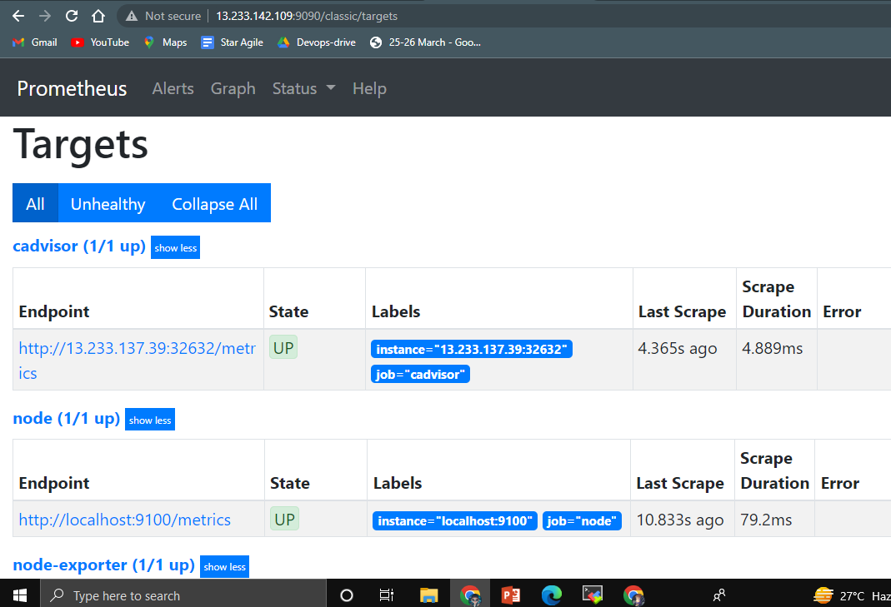
Cadvisor and Node-exporter are UP ans Running.

Slide 28
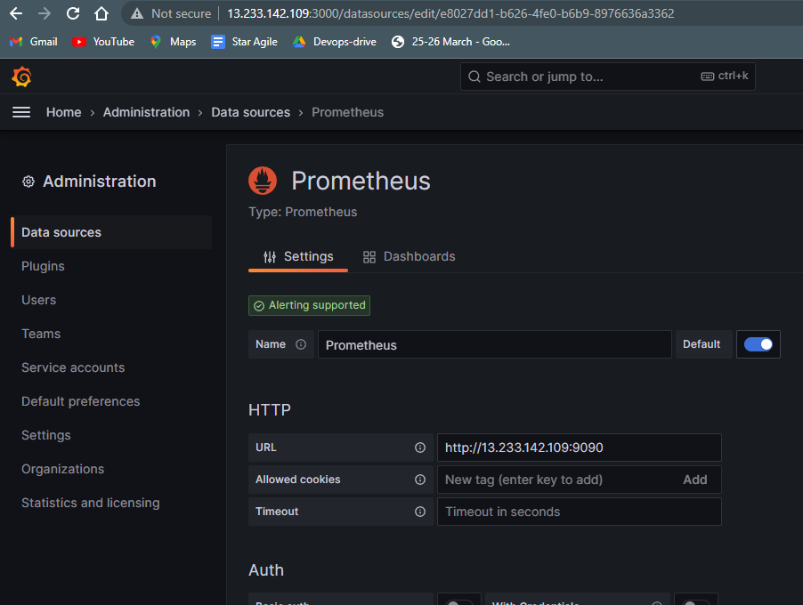
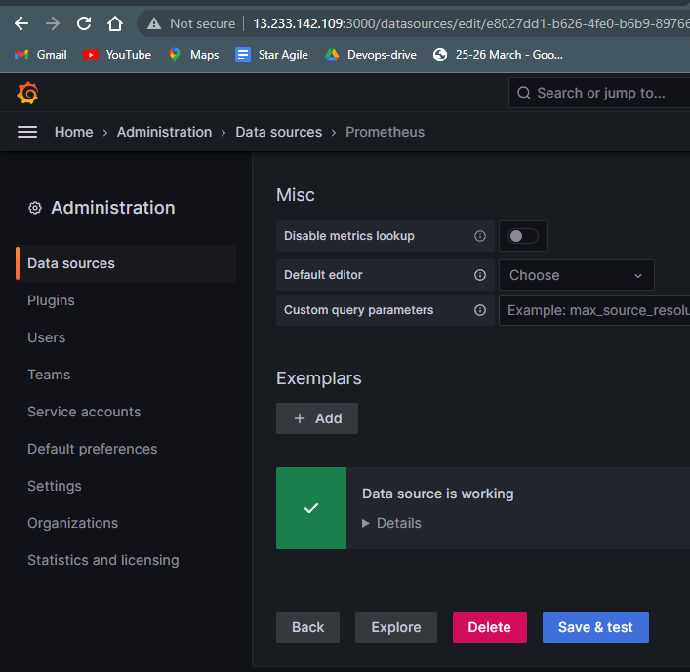
Adding Prometheus as the data source in Grafana server.

Slide 29
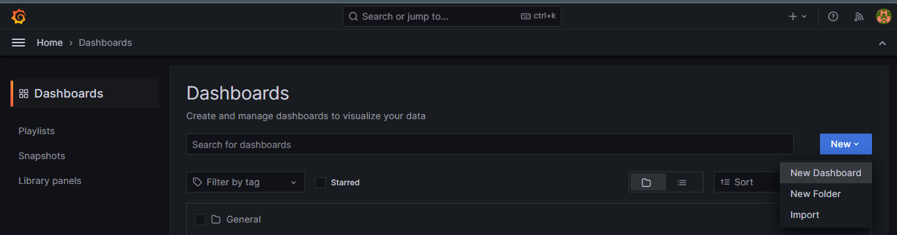
Launching a new dashboard on grafana server.

Slide 30
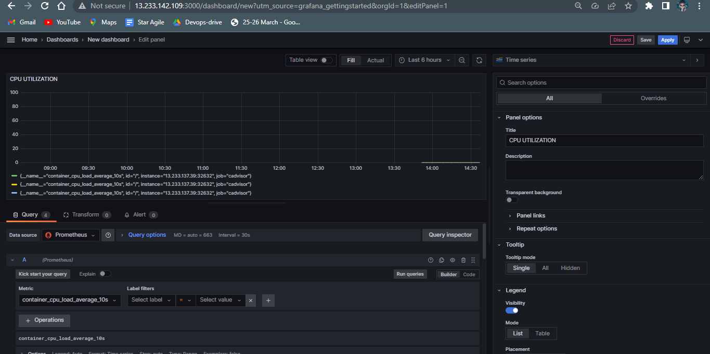
CPU Utilization Panel

Slide 31
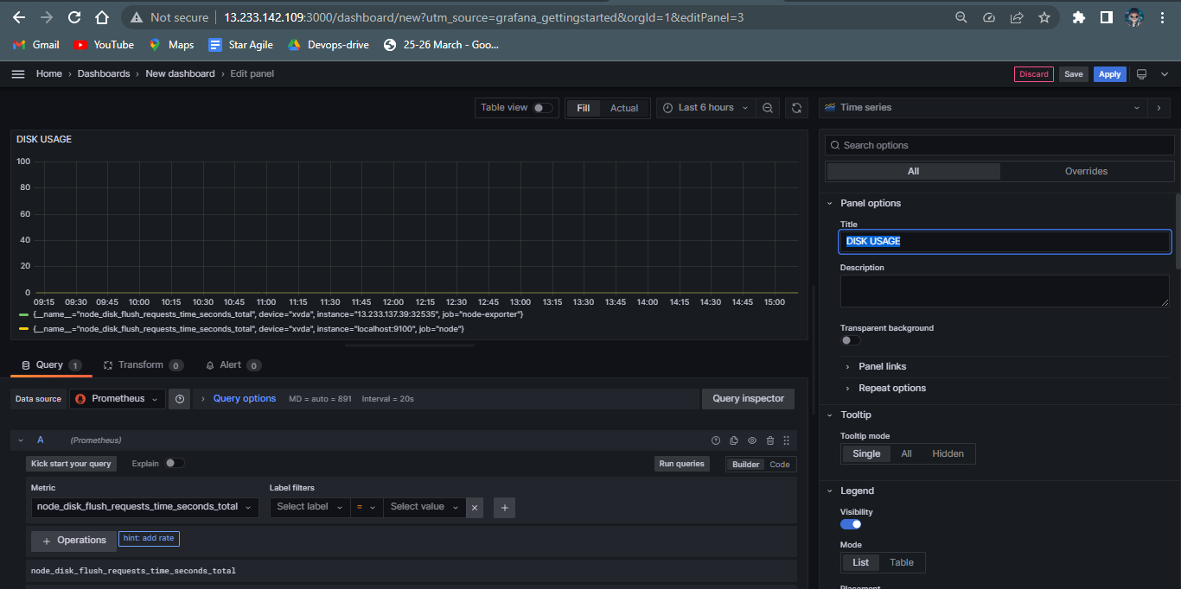
CPU Usage visualization panel

Slide 32
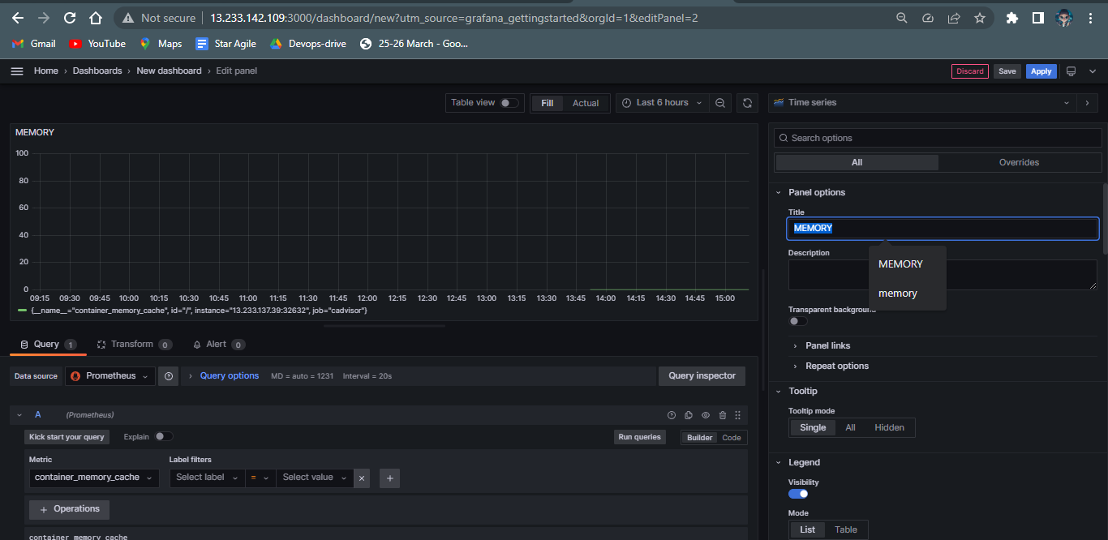
Memory Utilization panel

Slide 33
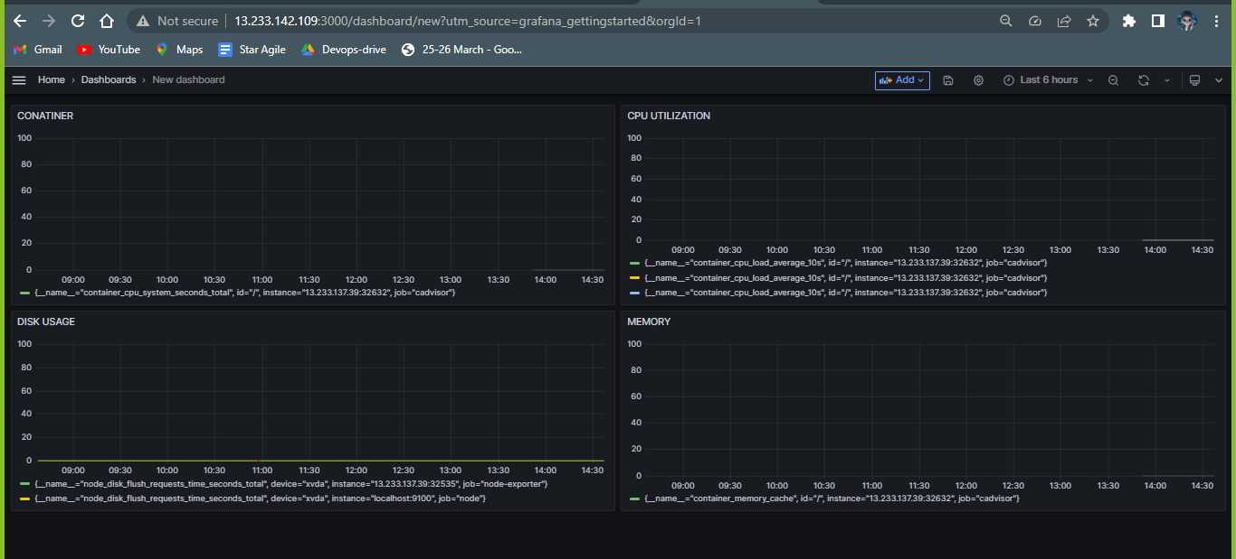
The Panel Dashboard

Slide 34
DONE BY:
ISHRATH FATIMA

